Slide 1







Experimental Design Principles
Alex Sánchez^{1,2}, Ricardo Gonzalo²
Statistics and Bioinformatics Research Group
Department of Genetics, Microbiology and Statistics Universitat de Barcelona (UB)
Statistics and Bioinformatics Unit (UEB)
Vall d’Hebron Institut de Recerca (VHIR)
Notes:
1

Slide 2
Basic ideas of experimental design
Experimental Design Types
  Randomize
  Replicate
  Local control
Experimental Design types
  Completely Randomized Design (CRD)
  Randomized Block Design (RBD)
  Factorial Experiments
  Repeated Measures (Within Subjects Designs)
Some references
Exercises

Slide 3

Basic Ideas of Experimental Design
Why are many life scientists so adverse to thinking about design?
It is common to think that time spent designing experiments would be better spent actually doing experiments
Some myths arise in biologists and statistical fields about that.
  “It does not matter how you collect your data, there will always be a statistical ‘fix’ that will allow you to analyse them”
  “If you collect lots of data something interesting will come out, and you’ll be able to detect even very subtle effects”
  “In science, as in life: more haste, less speed”

Slide 4
Basic Ideas of Experimental Design
Why Experiment?
Researchers use experiments to answer questions:
    Is a drug a safe, effective cure for a disease?
    Which combination of protein and carbohydrate sources provides the best nutrition for growing lambs?
    …
  Experiments usually want to compare some treatments induced to some items and then measure one or more responses.
This could tell us if there are any differences in responses between treatments, what the estimated sizes of those differences are,….
UNDERSTAND A PROCESS

Slide 5
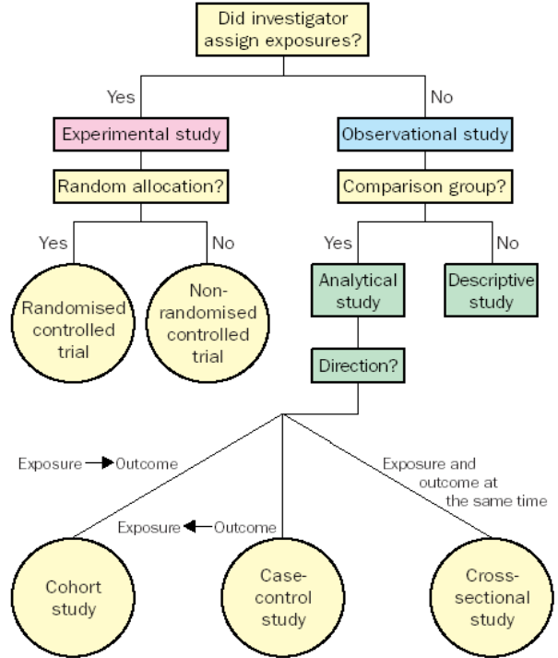
Basic Ideas: Study types
http://www.cebm.net/wp-content/uploads/2014/06/CEBM-study-design-april-20131.pdf
But see also:
Types of Study in Medical Research
Or
Types of Studies - Introduction to Evidence-Based Practice

Slide 6
Basic Ideas of Experimental Design
Components of an experiment
  An experiment is characterized by the treatments and experimental units to be used, the method treatments are assigned to units and the responses are measured.
  Treatments, units, and assignment method specify the experimental design.
    What about analysis? Analysis is not part of design, but MUST be consider during planning.

Slide 7
Basic Ideas of Experimental Design
Some important definitions:
Treatment: The set of circumstances created for the experiment in response to the research hypothesis (15º + 50%).
Factor: A set of treatments grouped together logically (Temperat., humidity).
Level: The several categories of a factor (15º, 25º, 37º).
Responses: outcomes that we observe after applying a treatment to an experimental unit. Often more than one response is obtained
Randomization: probabilistic mechanism for the assignment of treatment units

Slide 8
Basic Ideas of Experimental Design
Some important definitions:
  Experimental unit: sample exposed to the treatment. The things to which we apply the treatments (patient, alumni, brain region)
  Measurement unit: Unit where the measures are collected. It could be indistinguishable from experimental unit (patient, classroom, mouse)
Experimental Error: random variation present in all experimental results
Observational Error: The variation among multiple observations from the same experimental unit.

Slide 9

Basic Ideas of Experimental Design
Some important definitions:
Confounding: occurs when the effect of one factor o treatment cannot be distinguished from that of another factor o treatment.
Blinding: When the evaluators of a response do not know which treatment was given to which unit
Block: block of units is a set of units that are homogeneous in some sense
Fixed factor: has a finite number of levels.
Random factor: can have many levels and the experiment usually tests a sample of levels

Slide 10


Basic Ideas of Experimental Design
Variability types that play a role in an experiment:
Planned systematic variability: This is the differences in response between treatments applied.
Noise variability: random noise. Differences between two consecutives measures. We cannot avoid that.
Systematic variability not planned: Produce a systematic variation in the results. A priori the reason is not known. It can be avoided with the randomization and the local control.

Slide 11
Basic Ideas of Experimental Design
Important steps to define before begin the experiment:
Establish main objectives of the experiment.
Identify all noise sources: Treatment, experimental errors,…
Allocate each experimental unit within each treatment
Clarify the type of response expected in each treatment
Determinate the number of individuals in each group
Run a pilot study
How the data will be statistically analysed.

Slide 12
Basic Ideas of Experimental Design
Important steps to define before begin the experiment:
Establish main objectives of the experiment.
Identify all noise sources: Treatment, experimental errors,…
Allocate each experimental unit within each treatment
Clarify the type of response expected in each treatment
Determinate the number of individuals in each group
Run a pilot study
How the data will be statistically analysed.

Slide 13
Basic Ideas of Experimental Design
Important steps to define before begin the experiment:
Establish main objectives of the experiment.
Identify all noise sources: Treatment, experimental errors,…
Allocate each experimental unit within each treatment
Clarify the type of response expected in each treatment
Determinate the number of individuals in each group
Run a pilot study
How the data will be statistically analysed.

Slide 14
Basic Ideas of Experimental Design
Important steps to define before begin the experiment:
Establish the main objectives of the experiment. Avoid collateral problems
Identify all the noise sources: Treatment, experimental errors,…
Allocate each experimental unit which each treatment
Clarify the type of response expected in each treatment
Determinate the number of individuals in each group
Run a pilot study
How the data will be statistically analysed.

Slide 15
Basic Ideas of Experimental Design
Why Experimental Design?
We can design experiments to minimize any bias in the comparison
We can design experiments so that the error in the comparison is small
  Very Important: We are in control of experiments, and having that control allow us to make stronger inferences about the nature of differences that we see in the experiment.
  We will be able to make inferences about causation
This point distinguishes an experiment from an observational study.
(drawback of observational studies is that the grouping into “treatments” is not under the control of the experimenter and its mechanism is usually unknown)

Slide 16
Basic Ideas of Experimental Design
Why Experimental Design?
To save money and time
  Less probability of bad results (mistakes,…)
  Only analyze the samples strictly necessary (less reagents, time,…)
  Only collect the data you need to answer the objectives
Ethical issues
  Only use the animals needed
  Treatment applied to the necessary animals
  Careful when applying the treatments

Slide 17
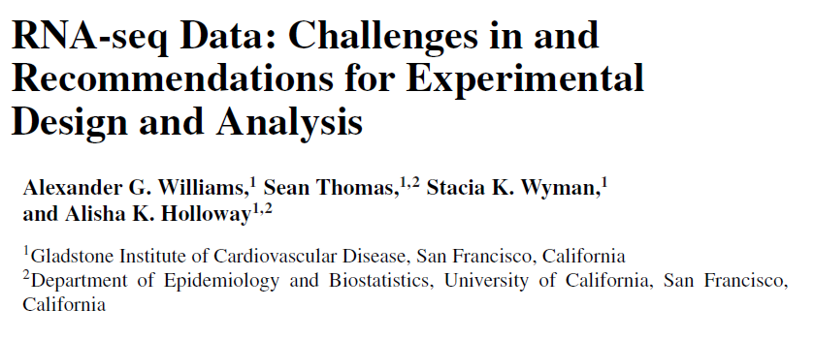

Basic Ideas of Experimental Design

Slide 18
Basic Ideas of Experimental Design
A good experimental design must…
Avoid systematic error: e.g. samples from one group processed with instrument A and samples from the other group processed with instrument B.
Be precise: try to maintain the random error as low as possible
Allow estimation of error: enough replicates in each treatment
Have broad validity: our experimental units should reflect the population about which we wish to draw inference

Slide 19
Basic ideas of experimental design
Experimental Design Principles
  Randomize
  Replicate
  Local control
Experimental Design types
  Completely Randomized Design (CRD)
  Randomized Block Design (RBD)
  Factorial Experiments
  Repeated Measures (Within Subjects Designs)
Some references
Exercises

Slide 20
Experimental Design Principles
1. Randomize
A good experimental design must…
Avoid systematic error: e.g. samples from one group processed with instrument A and samples from the other group processed with instrument B.
Be precise: try to maintain the random error as low as possible
Allow estimation of error: enough replicates in each treatment
Have broad validity: our experimental units should reflect the population about which we wish to draw inference
Randomize
Local Control
Replicate

Slide 21
Experimental Design Principles
1. Randomize
Randomize
The method for assigning treatments to units involves randomization (“any individual experimental subject has the same chance as any other individual of finding itself in each experimental group”)
It is one of the most important elements of a well-designed experiment
Made valid most of the statistical analysis usually performed
Haphazard is not randomized
e.g. 4 treatments to be assigned to 16 units
  Use sixteen identical slips of paper, 4 marked with A, 4 with B, and so on to D. Put the slips of paper into a basket and mix them thoroughly. For each unit, we draw a slip of paper from the basket and use the treatment marked on the slip
  Treatment A is assigned to the first four units we have encounter, treatment B to next four units, and so on.

Slide 22
Experimental Design Principles
1. Randomize
Randomize
The method for assigning treatments to units involves randomization (“any individual experimental subject has the same chance as any other individual of finding itself in each experimental group”)
It is one of the most important elements of a well-designed experiment
Made valid most of the statistical analysis usually performed
Haphazard is not randomized
e.g. 4 treatments to be assigned to 16 units
  Use sixteen identical slips of paper, 4 marked with A, 4 with B, and so on to D. Put the slips of paper into a basket and mix them thoroughly. For each unit, we draw a slip of paper from the basket and use the treatment marked on the slip
  Treatment A is assigned to the first four units we have encounter, treatment B to next four units, and so on.

Slide 23
Experimental Design Principles
1. Randomize
Randomization against confounding
The effect of the treatment cannot be distinguished from another
e.g. Consider a new drug treatment for coronary artery disease. 2 treatments to compare: this drug treatment with bypass surgery. We have 100 patients in our pool of volunteers; they need to be assigned to the two treatments. We then measure five-year survival as a response.
What sort of trouble can happen if we fail to randomize? Bypass surgery is a major operation, and patients with severe disease may not be strong enough to survive the operation:
- stronger patients to surgery and the weaker patients to the drug therapy.
This confounds strength of the patient with treatment differences. The drug therapy would likely have a lower survival rate because it is getting the weakest patients, even if the drug therapy is every bit as good as the surgery.

Slide 24


Experimental Design Principles
1. Randomize
Randomization against confounding
e.g. Cont.
Patient 1 to 100
Surgery
Drug therapy

Slide 25
Experimental Design Principles
1. Randomize
Saying “randomly assign…” is sometimes easier to say than to do, especially in complex designs.
Some tools may help
  Research Randomizer
  http://www.randomizer.org/
  Interactive Statistical Calculation pages
  http://statpages.org/
  (look por “Experimental design”)

Slide 26
Experimental Design Principles
2.Replicate
Replication is the basis of all experimental design
It is the repetition of the basic experiment with another experimental units
To keep in mind:
    It is important to be aware of the variability of the technology used
    Previous works with similar technology
    Directly correlated with the precision of the experiment
the more replicates we have, the more confident we can be that differences between groups are real and not simply due to chance effects
How many replicates I need?
More replicates increase in time/money cost

Slide 27
Experimental Design Principles
2. Replicate
    Technical
    Biological
Which type of replicates?
Statistical power: is the probability that a particular experiment will detect a difference, assuming that there really is a difference to be detected.
    Effect size
    amount of random variation
    number of replicates
      There are computer programs to calculate it (you must provide effect sizes and estimates of variation) (http://homepage.stat.uiowa.edu/~rlenth/Power)
Pooling samples: To pool or not to pool?

Slide 28
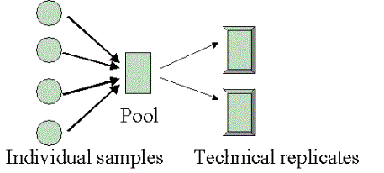
Experimental Design Principles
2. Replicate
Pooling samples: To pool or not to pool?
mRNA from different samples are often combined to form a ``pooled-sample’’ or pool. Why?
  If each sample doesn’t yield enough mRNA
  To compensate an excess of variability?
Pooling may be misleading but is OK if properly done
  Combine several samples in each pool
  Use several pools from different samples
  Do not use pools when individual information is important (e.g. paired designs)
  Never substitute sampling by pooling (one sample with 3 individuals pooled != 3 individual samples !!!)

Slide 29
Experimental Design Principles
3. Local control
Local control
When the experimental units are not homogeneous (sex, smokers,…) or the process to analyze them neither are (Kits lot numbers, batch,…)
It transforms systematic variability not planned in planned systematic variability.
Differences among blocks could hide differences among treatments.
We are not interested in to find out the differences between the levels of the blocks

Slide 30
Experimental Design Principles
3. Local control
Local control
Sample | Treatment | Sex | Batch |  | Sample | Treatment | Sex | Batch
1 | A | Male | 1 |  | 1 | A | Male | 1
2 | A | Male | 1 |  | 2 | A | Female | 2
3 | A | Male | 1 |  | 3 | A | Male | 2
4 | A | Male | 1 |  | 4 | A | Female | 1
5 | B | Female | 2 |  | 5 | B | Male | 1
6 | B | Female | 2 |  | 6 | B | Female | 2
7 | B | Female | 2 |  | 7 | B | Male | 2
8 | B | Female | 2 |  | 8 | B | Female | 1

Slide 31
Experimental Design Principles
3. Local control
Local control
Sample | Treatment | Sex | Batch |  | Sample | Treatment | Sex | Batch
1 | A | Male | 1 |  | 1 | A | Male | 1
2 | A | Male | 1 |  | 2 | A | Female | 2
3 | A | Male | 1 |  | 3 | A | Male | 2
4 | A | Male | 1 |  | 4 | A | Female | 1
5 | B | Female | 2 |  | 5 | B | Male | 1
6 | B | Female | 2 |  | 6 | B | Female | 2
7 | B | Female | 2 |  | 7 | B | Male | 2
8 | B | Female | 2 |  | 8 | B | Female | 1
Treatment are confounded between sex and batch
Treatment is well balanced

Slide 32
Experimental Design Principles
3. Local control
Local control or randomize?
Local control assure you that differences are not due to blocks in the sample
Local control eliminate the noise due to differences among blocks
Randomization is good for balance effects from variables not taken into account from the beginning.
“Block what you can, randomize what you cannot” (George Box, 1978)

Slide 33
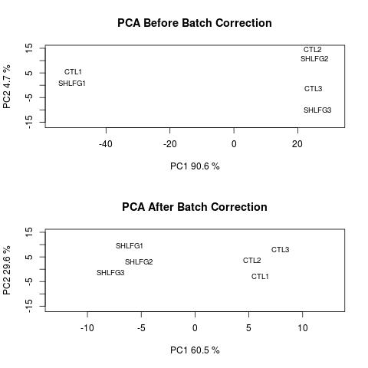
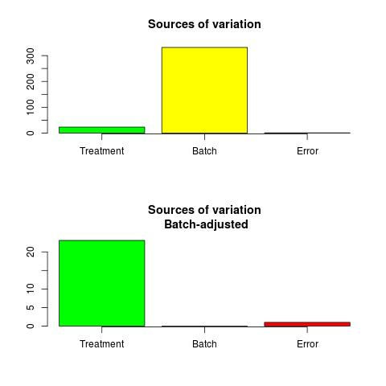
Experimental Design Principles
3. Local control
Example of a bad experimental design (or perhaps an absence of...)
2
1
2
1
3
3
1
3
2
2
3
1

Slide 34
Basic ideas of experimental design
Experimental Design Principles
  Randomize
  Replicate
  Local control
Experimental Design types
  Completely Randomized Design (CRD)
  Randomized Block Design (RBD)
  Factorial Experiments
  Repeated Measures (Within Subjects Designs)
Some references
Exercises

Slide 35
Experimental Design types
A key point in any experiment is the way that experimental units are allocated to treatments
  It must be chosen so that random variability is as small as possible.
  It must be chosen so that the best local control is achieved.
  It implicitly defines the analysis model, so it must be chosen so that the analysis can be performed and validity conditions hold.

Slide 36
Experimental Design types
Experimental Design types
More common are:
Completely randomized design (CRD)
Randomized Block design (RBD)
Factorial designs
Nested designs
  Repeated measures designs
Notes:
36

Slide 37
Experimental Design types
  Completely Randomized Design (CRD)
Simplest of all designs
Uses randomization and replication.
  Treatments are allocated at random to experimental units over the entire experimental material
  Replicated r times (defined by power analysis & cost).
Useful in laboratory settings where it is possible to have homogenous experimental material.
  Biological variability controlled keeping same cell line
  Technical variability reduced by using same technique and same machine for the entire samples at once.
Model:
Response = constant + treatment effect + error
Notes:
37

Slide 38
Experimental Design types
  Completely Randomized Design (CRD)
CRD Example. Gene therapy experiment:
Compare four techniques for correcting faulty genes
  A: normal gene inserted in non-specific location
  B: Modified gene swapped for a normal gene
  C: Modified gene repaired through selective reverse mutation
  D: Regulation of a particular gene altered
20 independent individuals are selected
Treatments are assigned at random
Experiment is performed, gene expression is measured and data are analyzed using one-way ANOVA.
Notes:
38
Gene therapy is a technique for correcting defective genes responsible for the disease development.
Researchers may use one of several approaches for correcting faulty genes:
Technique A: A normal gene may be inserted into a nonspecific location within the genome to replace a nonfunctional gene. Most common approach.
Technique B: An abnormal gene could be swapped for a normal gene through homologous recombination.
Technique C: The abnormal gene could be repaired through selective reverse mutation, which returns the gene to its normal function.
Technique D: The regulation (the degree to which a gene is turned on or off) of a particular gene could be altered.

Slide 39
Experimental Design types
  Completely Randomized Design (CRD)
Suma de Response | Subjects
TREAT | 1 | 2 | 3 | 4 | 5
A | 96 | 99 | 100 | 104 | 84
B | 91 | 90 | 75 | 80 | 90
C | 70 | 90 | 84 | 76 | 78
D | 78 | 87 | 67 | 66 | 76
TREAT | RESPONSE
A | 96
A | 99
A | 100
A | 104
A | 84
B | 91
B | 90
B | 75
B | 80
B | 90
C | 70
C | 90
C | 84
C | 76
C | 78
D | 78
D | 87
D | 67
D | 66
D | 76
Human readable format
Computer processable format
Notes:
39

Slide 40
Experimental Design types
  Randomized Block Design (RBD)
CRD becomes less informative if the experimental material is not homogenous.
Blocking may be used to divide the whole experimental material into homogeneous strata or sub-groups known as blocks.
After blocking, if the treatments are applied to experimental units randomly, the design is called Randomized Block Design (RBD).
Model:
Response = mean + treatment effect + block effect + error
Notes:
40
The randomization is restricted within the blocks.
Each treatment has the same number of replications.
Assumes that there is no interaction between treatments and blocks.
The RBD is a good method to analyze the data when the experiments are spread over a period of time or space and the possibility of systematic variation or trends exists.
There is no restriction on the number of replicates needed or treatment needed, but in general, at least two replicates are required to carry out the test of significance.
Also some other treatments may be included more than once without making the analysis bit more complicated.
The error of any treatment can be isolated and any number of treatments may be omitted from the analysis without complicating the analysis.
The RBD is not recommended when a large number of treatments and blocks have considerable variability.

Slide 41
Experimental Design types
  Randomized Block Design (RBD)
RBD example: Regenerative treatment
After exposure to a toxic, cells can be treated by different substances that accelerate regeneration.
A study wishes to compare six such growth factors (5 are treatments and 1 is a control).
A confusion has caused that there is not enough culture medium to grow all treatments with replicates. Instead there are 4 culture mediums available.
What can be done?: Block by culture medium type
  Prepare 4 groups of 6 plates, each group of one culture type
  In each group : randomly assign a different treatment to each one of the six plates.
Notes:
41

Slide 42
Experimental Design types
  Randomized Block Design (RBD)
medium | Tx | Regeneration
1 | 1 | 34.98
2 | 1 | 41.22
3 | 1 | 36.94
4 | 1 | 39.97
1 | 2 | 40.89
2 | 2 | 46.69
3 | 2 | 46.65
4 | 2 | 41.9
1 | 3 | 42.07
2 | 3 | 49.42
3 | 3 | 52.68
4 | 3 | 42.91
1 | 4 | 37.18
2 | 4 | 45.85
3 | 4 | 40.23
4 | 4 | 39.2
1 | 5 | 37.99
2 | 5 | 41.99
3 | 5 | 37.61
4 | 5 | 40.45
1 | 6 | 34.89
2 | 6 | 50.15
3 | 6 | 44.57
4 | 6 | 43.29
 | Culture Medium (Block)
Tx | 1 | 2 | 3 | 4
1 | 34.98 | 41.22 | 36.94 | 39.97
2 | 40.89 | 46.69 | 46.65 | 41.9
3 | 42.7 | 49.42 | 52.68 | 42.91
4 | 37.18 | 45.85 | 40.23 | 39.2
5 | 37.99 | 41.99 | 37.61 | 40.45
6 | 34.89 | 50.15 | 44.57 | 43.29
Notes:
42

Slide 43
Experimental Design types
  Randomized Block Design (RBD)
Block what you can and randomize what you cannot – Box, Hunter& Hunter (1978)
  Blocking ensures that the differences between treatments cannot possibly be due to blocking factors
  Blocking eliminates noise due to differences between blocks,
  Randomization gives approximate balance across other variables unaccounted for.
Notes:
43

Slide 44
Experimental Design types
  Factorial Design
Factorial Design
Effects of several factors of variation are studied simultaneously.
The treatments are all the combinations of different factors under study.
The effects of each of the factors and the interaction effects, which are the variations in the effect of one factor as a result to different levels of other factors, are studied.
Response = mean+ treat-1 effect + treat-2 effect +treat-1:2-Interaction + error
Notes:
44

Slide 45
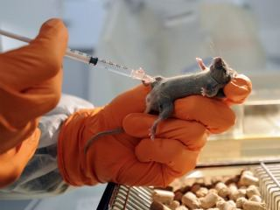
Experimental Design types
  Factorial Design
Factorial design Example 1. Effect of Chloramphenicol and diet.
A study was performed to determine the effect of chloramphenicol and the diet on certain hematological parameters of mice.
Table 1 shows WBCC (white blood cell counts) counts in mice nourished with two distinct diets kept as controls or treated with chloramphenicol.
  Mice (of comparable age and from the same breeder) were assigned at random to each combination of group and diet and after an appropriate time the mice were bled and the WBCC were obtained
Notes:
45

Slide 46
Experimental Design types
  Factorial Design
# Replica Trx Diet WBC
1 1 Control CD1 3.0
2 2 Control CD1 1.7
3 3 Control CD1 1.5
4 4 Control CD1 2.0
5 5 Control CD1 2.1
6 1 Trx CD1 1.9
7 2 Trx CD1 1.9
8 3 Trx CD1 3.5
9 4 Trx CD1 1.2
10 5 Trx CD1 2.3
11 1 Control CBA 1.9
12 2 Control CBA 2.6
13 3 Control CBA 1.4
14 4 Control CBA 1.6
15 5 Control CBA 1.1
16 1 Trx CBA 0.4
17 2 Trx CBA 0.2
18 3 Trx CBA 0.1
19 4 Trx CBA 0.4
20 5 Trx CBA 0.3
Treatment | Diet
 | CD-1 | CBA
C | 3 | 1.9
C | 1.7 | 2.6
C | 1.5 | 1.4
C | 2 | 1.6
C | 2.1 | 1.1
T | 1.9 | 0.4
T | 1.9 | 0.2
T | 3.5 | 0.1
T | 1.2 | 0.4
T | 2.3 | 0.3

Slide 47
Experimental Design types
  Factorial Design
Factorial design Example
A study was performed to study the effect of a drug and diet on systolic blood pressure.
  • 20 individuals with high blood pressure were randomly assigned to one of four treatment conditions.
    • Control group (Neither drug nor diet modification)
    • Diet modification only
    • Drug only
    • Both drug and diet modification
  • At the end of the treatment period, SBP was assessed.
  This is a factorial design where each of two treatments (drug, diet) can be randomly assigned to each individual.
  • Having 20 individuals there can be replicates of each treatment combination and so interaction between drug and diet can be estimated.

Slide 48
Experimental Design types
  Factorial Design
SBP | Diet | Drug
185 | 1 | 1
190 | 1 | 1
195 | 1 | 1
200 | 1 | 1
180 | 1 | 1
171 | 1 | 2
176 | 1 | 2
181 | 1 | 2
166 | 1 | 2
161 | 1 | 2
188 | 2 | 1
183 | 2 | 1
198 | 2 | 1
178 | 2 | 1
193 | 2 | 1
153 | 2 | 2
163 | 2 | 2
173 | 2 | 2
178 | 2 | 2
168 | 2 | 2
Drug/Diet | No Diet | Diet
 | 185 | 188
 | 190 | 183
No Drug | 195 | 198
 | 200 | 178
 | 180 | 193
 | 171 | 153
 | 176 | 163
Drug | 181 | 173
 | 166 | 178
 | 161 | 168

Slide 49
Experimental Design types
  Repeated measures
Repeated measures
When more than one measure is taken on each experimental unit one has a within subjects design:
  Measures on the same individual are correlated
  New source of variability to be accounted for:
      variability within subjects
  Same possibilities as with other designs
  With an extra source of variation (“time”)

Slide 50
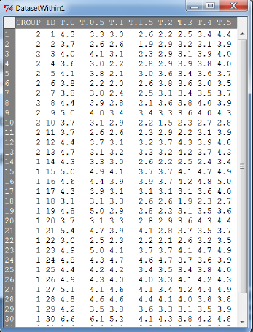
Experimental Design types
  Repeated measures
Repeated measures Example:
• A study on plasma inorganic phosphate after oral glucose tolerance test (OGTT) was performed on 33 individuals.
  – Two groups: Control (1) and obese (2)
  –Phosphate levels were measured before test (time=0) and 0.5, 1.5, 2, 3, 4 and 5 hours after test.

Slide 51
Basic ideas of experimental design
Experimental Design Principles
  Randomize
  Replicate
  Local control
Experimental Design types
  Completely Randomized Design (CRD)
  Randomized Block Design (RBD)
  Factorial Experiments
  Repeated Measures (Within Subjects Designs)
Some references
Exercises

Slide 52
Some references...
Some links...
http://www.3rs-reduction.co.uk/html/main_menu.html (An interactive short course on experimental design for research scientists working with laboratory animals)
http://www.tfrec.wsu.edu/anova/index.html (A field guide to Experimental Designs)
http://www.stats.gla.ac.uk/steps/glossary/anova.html (Experimental Designs & ANOVA)
Some books...
Experimental design for the life sciences (Graeme D. Ruxton, Nick Colegrave)
  Excellent book, not very mathematical (“qualitative approach”, modern & detailed)
A first course in design and analysis of experiments (Gary W. Oehlert)
  Very good book. More mathematic (assumes basic knowledge of statistical inference)
  Nice web site: http://users.stat.umn.edu/~gary/Book.html

Slide 53
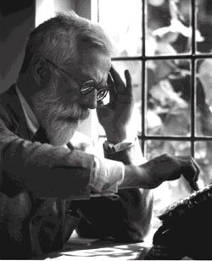
So, should we account for Experimental Design?
To consult the statistician after an experiment is finished, is often merely to ask him to conduct a post mortem examination.
He can perhaps say what the experiment died of.
Sir Ronald A. Fisher
Father of modern Mathematical Statistics and Developer of Experimental Design and ANOVA

Slide 54
Take home message
Good experimental design is essential to perform good experiments.
Experimental design means planning ahead
    Should be done before the experiment starts
      Should consider all the steps: from sampling to data analysis
  Call your favorite biostatistician before the experiment begins, not to bring her the data you have collected!

Slide 55
Basic ideas of experimental design
Experimental Design Types
  Randomize
  Replicate
  Local control
Experimental Design types
  Completely Randomized Design (CRD)
  Randomized Block Design (RBD)
  Factorial Experiments
  Repeated Measures (Within Subjects Designs)
Some references
Exercises

Slide 56
Exercises
Exercise 1.
High cholesterol level in people may be reduced by exercise or by drug treatment. A pharmaceutical company has developed a new cholesterol-reducing drug. Researchers would like to compare its effect to the effects of the cholesterol-reducing drug that is currently on the market. Volunteers who have a history of high cholesterol and who are currently not on medication will be recruited to participate in the study.
A. Explain how you would carry out a completely randomized experiment for the study.
B. Describe an experimental design that would improve the design in part A by incorporating blocking.
C. Can the experiment in part B be carried out in a double blind manner? Explain.

Slide 57
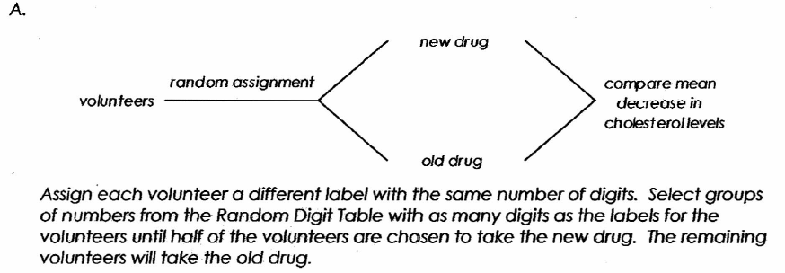
Exercises
Exercise 1. Solution

Slide 58
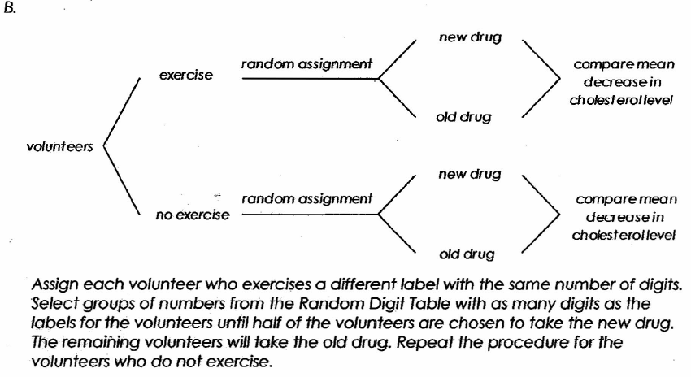
Exercises
Exercise 1. Solution

Slide 59
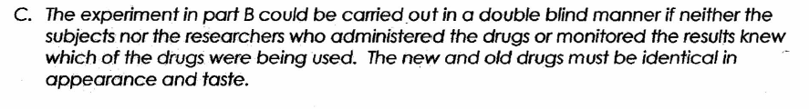
Exercises
Exercise 1. Solution

Slide 60
Exercises
Exercise 2.
A preliminary study conducted at a medical center in St. Louis has shown that treatment with magnets reduces the self-reported level of pain in polio patients. During each session, a patient rested on an examining table in the doctor's office while the magnets, embedded in soft pads, were strapped to the body at the site of pain. Sessions continued for several weeks, after which pain reduction was measured.
A new study is being designed to investigate whether magnets also reduce pain in patients suffering from herniated disks in the lower back. One hundred male patients are available for the-new study.
  Describe an appropriate design for the new study. Your discussion should briefly address treatments used, methods of treatment assignment, and what variables would be measured. Do not describe how the data would be analyzed.
  Would you modify the design above if, instead of 100 male patients, there were 50 male and 50 female patients available for the study? If so, how would you modify your design? If not, why not?

Slide 61
Exercises
Exercise 2. Solutions
100 male patients
A)
50 male patients: magnets in pads
Random assignment
Measure and compare self-reported level of pain
50 male patients: no magnets in pads
B)
25 male patients: magnets in pads
100 patients
Measure and compare self-reported level of pain
50 male patients:
random assignment
25 male patients: no magnets in pads
25 female patients: magnets in pads
50 female patients:
random assignment
Measure and compare self-reported level of pain
25 female patients: no magnets in pads

